Slide 1
Sensors and Image Formation
Imaging sensors and models of image formation
Coordinate systems

Slide 2
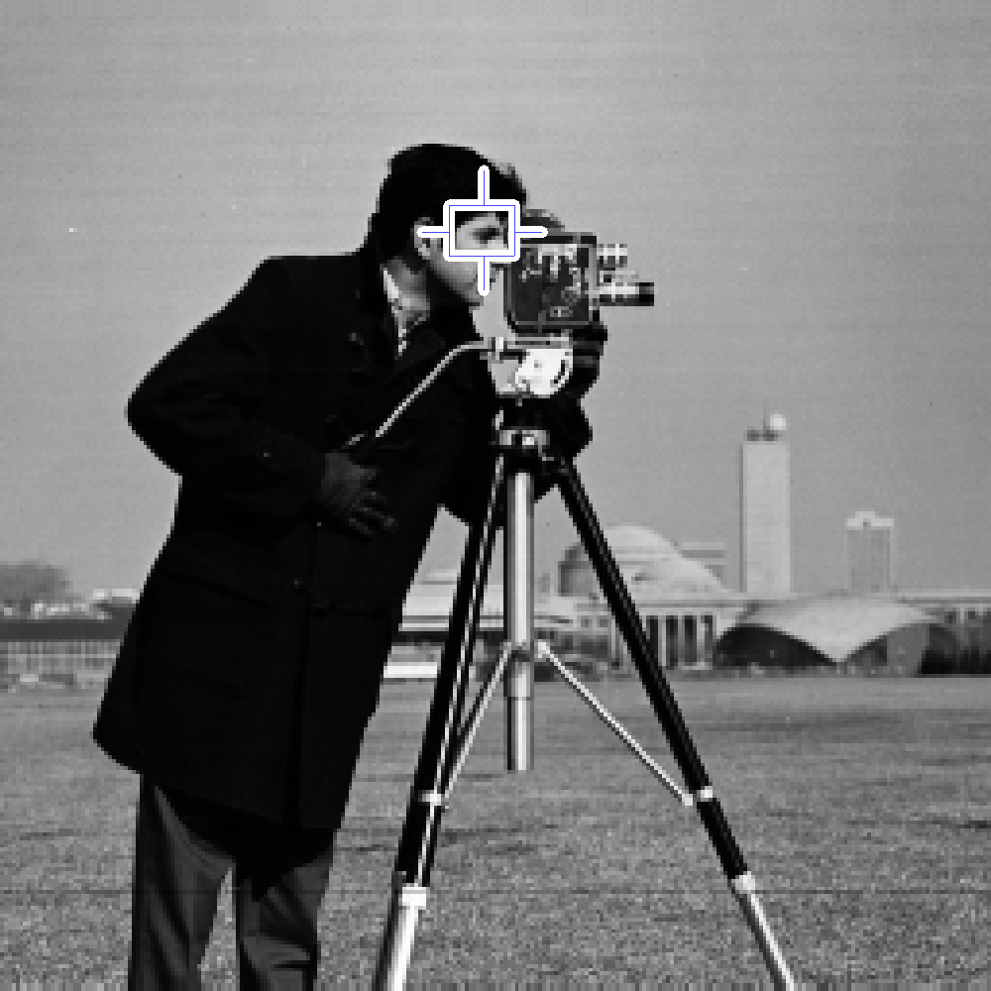
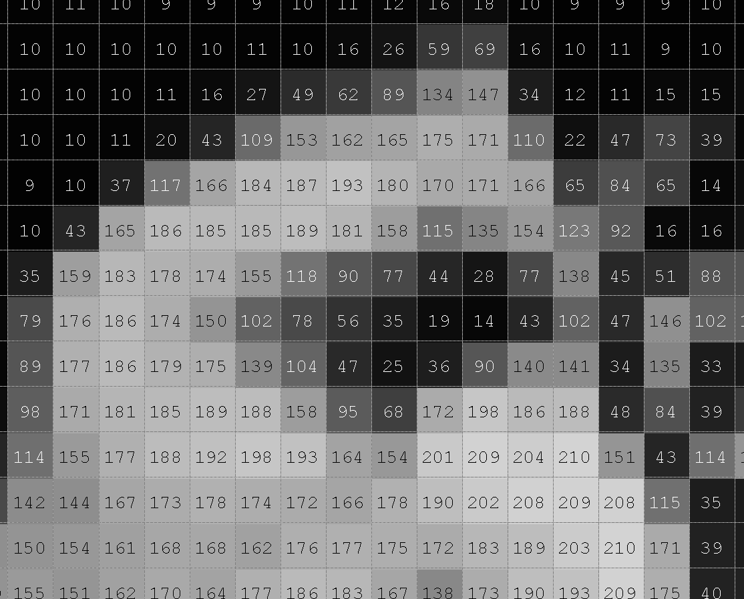
Digital Images
Digital images are stored as arrays of numbers
Numbers can represent
Intensity (gray level, or each color band)
Range
X-ray absorption coefficient
etc

Slide 3
Intensity Image Sensors
Basic elements of an imaging device
Aperture
An opening (or “pupil”) to limit amount of light, and angle of incoming light rays
Optical system
Lenses - purpose is to focus light from a scene point to a single image point
Imaging photosensitive surface
Film or sensors, usually a plane
Optical axis
Image plane
Optical system
aperture

Slide 4
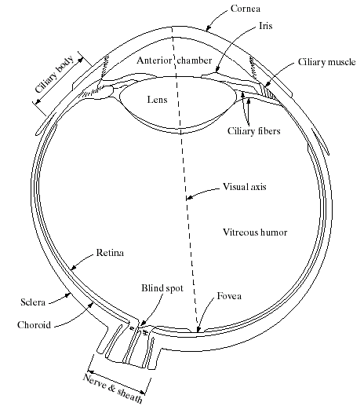
Biological Vision – A Guide to Developing Computer Vision?
A great deal of processing is done right in the retina
Data reduction of ~100 million receptors down to ~1 million optic nerve channels
Unfortunately, it is pre-attentive
Difficult to measure and study detailed function
Further processing done in the visual cortex
Specialized detectors for motion, shape, color, binocular disparity
Evidence for maps in the cortex in correspondence to the image
Still, it is an existence proof that it can be done, and well
Notes:
Eyeball is about 20 mm in diameter
Retina contains both rods and cones
Fovea is about 1.5 mm in diameter, contains about 337,000 cones
Focal length about 17 mm

Slide 5
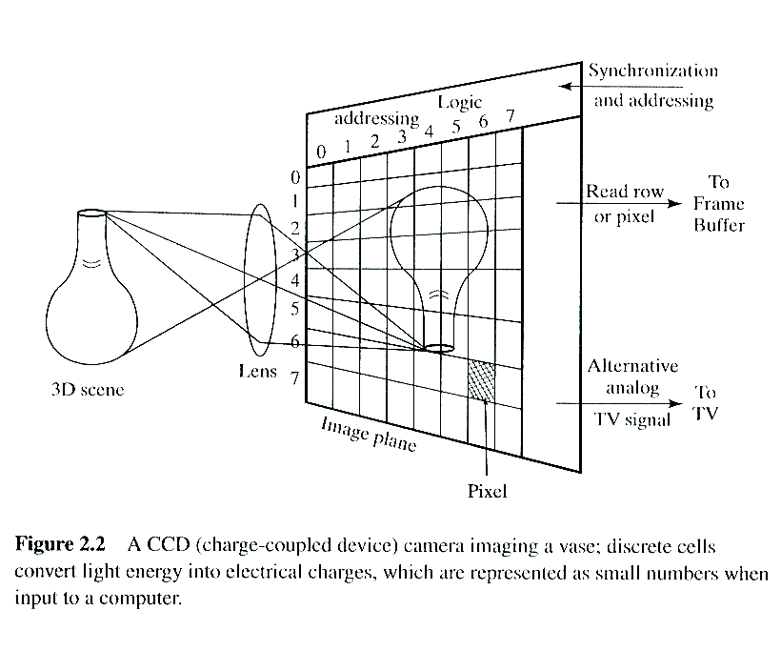
Digital Camera
Image plane is a 2D array of sensor elements
CCD type (Charge coupled device)
Charge accumulates during exposure
Charges are transferred out to shift registers, digitized and read out sequentially
CMOS type (complementary metal oxide on silicon)
Light affects the conductivity (or gain) of each photodetector
Digitized and read out using a multiplexing scheme
Main design factors
Number and size of sensor elements
Chip size
ADC (analog to digital conversion) resolution

Slide 6
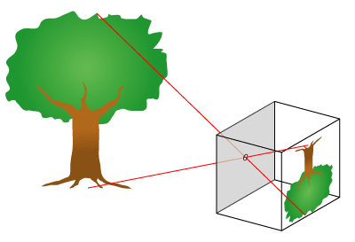
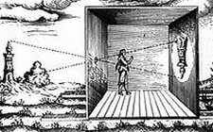
Pinhole Camera Model
A good lens can be modeled by a pinhole camera; ie., each ray from the scene passes undeflected to the image plane
Simple equations describe projection of a scene point onto the image plane (“perspective projection”)
We will use the pinhole camera model exclusively, except for a little later in the course where we model lens distortion in real cameras
The pinhole camera (“camera obscura”) was used by Renaissance painters to help them understand perspective projection

Slide 7
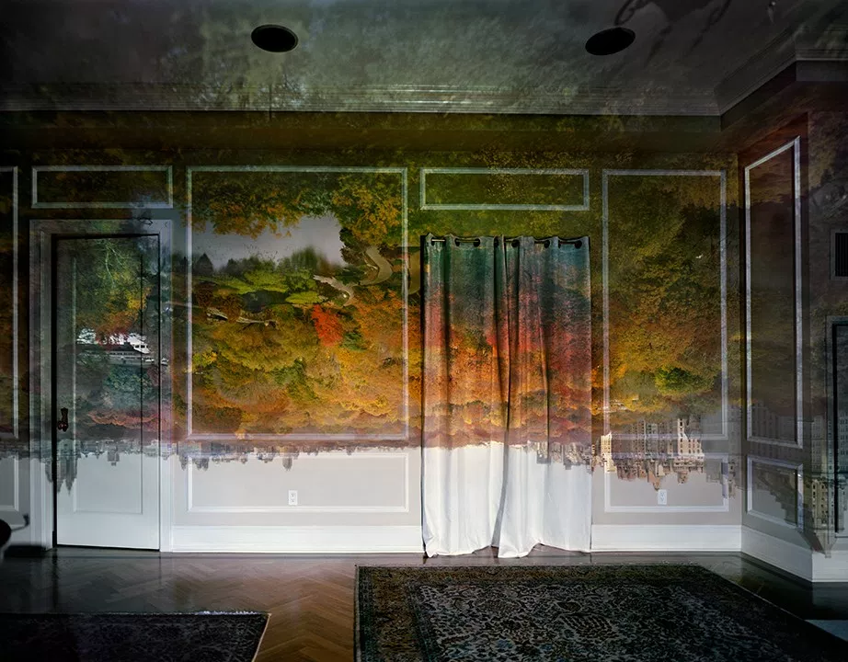

Slide 8

Photo Cred: Karl Samuelsen

Slide 9
Perspective Projection Equations
P(X,Y,Z)
X
Z
Given World Coordinates P(X,Y,Z) and focal length f, how do we calculate camera coordinates p(x,y)?

Slide 10
Perspective Projection Equations
The XYZ coordinates of the point are with respect to the camera origin
P(X,Y,Z)
X
Z
Given World Coordinates P(X,Y,Z) and focal length f, how do we calculate camera coordinates p(x,y)?

Slide 11
Perspective Projection Equations
The XYZ coordinates of the point are with respect to the camera origin
P(X,Y,Z)
X
Z
Given World Coordinates P(X,Y,Z) and focal length f, how do we calculate camera coordinates p(x,y)?
We define the origin of the camera’s coordinate system at the pinhole (note – this is a 3D XYZ coordinate frame

Slide 12
Perspective Projection Equations
The XYZ coordinates of the point are with respect to the camera origin
P(X,Y,Z)
X
p_{i}(x,y)
Z
Given World Coordinates P(X,Y,Z) and focal length f, how do we calculate camera coordinates p(x,y)?
We define the origin of the camera’s coordinate system at the pinhole (note – this is a 3D XYZ coordinate frame

Slide 13
Perspective Projection Equations
For convenience (to avoid an inverted image) we treat the image plane as if it were in front of the pinhole
The XYZ coordinates of the point are with respect to the camera origin
P(X,Y,Z)
p(x,y)
X
p_{i}(x,y)
Z
Given World Coordinates P(X,Y,Z) and focal length f, how do we calculate camera coordinates p(x,y)?
We define the origin of the camera’s coordinate system at the pinhole (note – this is a 3D XYZ coordinate frame

Slide 14
Perspective Projection Equations
For convenience (to avoid an inverted image) we treat the image plane as if it were in front of the pinhole
The XYZ coordinates of the point are with respect to the camera origin
P(X,Y,Z)
p(x,y)
X
Z
Given World Coordinates P(X,Y,Z) and focal length f, how do we calculate camera coordinates p(x,y)?
We define the origin of the camera’s coordinate system at the pinhole (note – this is a 3D XYZ coordinate frame

Slide 15
Perspective Projection Equations
For convenience (to avoid an inverted image) we treat the image plane as if it were in front of the pinhole
The XYZ coordinates of the point are with respect to the camera origin
P(X,Y,Z)
p(x,y)
X
Z
f = focal length
Given World Coordinates P(X,Y,Z) and focal length f, how do we calculate camera coordinates p(x,y)?
We define the origin of the camera’s coordinate system at the pinhole (note – this is a 3D XYZ coordinate frame

Slide 16
Perspective Projection Equations
For convenience (to avoid an inverted image) we treat the image plane as if it were in front of the pinhole
The XYZ coordinates of the point are with respect to the camera origin
P(X,Y,Z)
p(x,y)
X
Z
f = focal length
Given World Coordinates P(X,Y,Z) and focal length f, how do we calculate camera coordinates p(x,y)?
We define the origin of the camera’s coordinate system at the pinhole (note – this is a 3D XYZ coordinate frame
By similar triangles,
x=f X/Z, y=f Y/Z

Slide 17
Perspective Projection Equations
For convenience (to avoid an inverted image) we treat the image plane as if it were in front of the pinhole
The XYZ coordinates of the point are with respect to the camera origin
P(X,Y,Z)
p(x,y)
X
Z
f = focal length
We define the origin of the camera’s coordinate system at the pinhole (note – this is a 3D XYZ coordinate frame
Given the width of the image plane w and focal length f, how do we calculate the Field of view (θ)?

Slide 18
Perspective Projection Equations
For convenience (to avoid an inverted image) we treat the image plane as if it were in front of the pinhole
The XYZ coordinates of the point are with respect to the camera origin
P(X,Y,Z)
p(x,y)
X
Z
f = focal length
We define the origin of the camera’s coordinate system at the pinhole (note – this is a 3D XYZ coordinate frame
Given the width of the image plane w and focal length f, how do we calculate the Field of view (θ)?
θ/2
w/2
f

Slide 19
Perspective Projection Equations
For convenience (to avoid an inverted image) we treat the image plane as if it were in front of the pinhole
The XYZ coordinates of the point are with respect to the camera origin
P(X,Y,Z)
p(x,y)
X
Z
f = focal length
We define the origin of the camera’s coordinate system at the pinhole (note – this is a 3D XYZ coordinate frame
Given the width of the image plane w and focal length f, how do we calculate the Field of view (θ)?
w/2
tan(θ/2) = (w/2)/f so... θ = 2*tan⁻¹((w/2)/f)
θ/2
f

Slide 20
Camera vs Image Plane Coords
Camera coordinate system {C}
A 3D coordinate system (X,Y,Z) – units say, in meters
Origin at the center of projection
Z axis points outward along optical axis
X points right, Y points down
^{C}P(X,Y,Z)
{C}
x=f X/Z
y=f Y/Z
f
{π}
Image plane coordinate system {π}
A 2D coordinate system (x,y) – units in mm
Origin at the intersection of the optical axis with the image plane
In real systems, this is where the CCD or CMOS plane is

Slide 21
Examples
Assume focal length = 5 mm
A scene point is located at (X,Y,Z) = (1m, 2m, 5m)
What are the image plane coordinates (x,y) in mm?
If the image plane is 10mm x 10mm, what is the field of view?
A building is 100m wide. How far away do we have to be in order that it fills the field of view?

Slide 22
Examples
x = f X/Z = (5 mm) (1 m)/(5 m)
= 1 mm
y = f Y/Z = (5 mm) (2 m)/(5 m)
= 2 mm
Assume focal length = 5 mm
A scene point is located at (X,Y,Z) = (1m, 2m, 5m)
What are the image plane coordinates (x,y) in mm?
If the image plane is 10mm x 10mm, what is the field of view?
A building is 100m wide. How far away do we have to be in order that it fills the field of view?
x
y

Slide 23
Examples
x = f X/Z = (5 mm) (1 m)/(5 m)
= 1 mm
y = f Y/Z = (5 mm) (2 m)/(5 m)
= 2 mm
Assume focal length = 5 mm
A scene point is located at (X,Y,Z) = (1m, 2m, 5m)
What are the image plane coordinates (x,y) in mm?
If the image plane is 10mm x 10mm, what is the field of view?
A building is 100m wide. How far away do we have to be in order that it fills the field of view?
x
y
θ/2
10 mm
5 mm
tan(θ/2) = (w/2)/f = 5/5 = 1
so θ/2 = 45 deg, fov is 90x90 deg

Slide 24
Examples
x = f X/Z = (5 mm) (1 m)/(5 m)
= 1 mm
y = f Y/Z = (5 mm) (2 m)/(5 m)
= 2 mm
Assume focal length = 5 mm
A scene point is located at (X,Y,Z) = (1m, 2m, 5m)
What are the image plane coordinates (x,y) in mm?
If the image plane is 10mm x 10mm, what is the field of view?
A building is 100m wide. How far away do we have to be in order that it fills the field of view?
x
y
θ/2
10 mm
5 mm
tan(θ/2) = (w/2)/f = 5/5 = 1
so θ/2 = 45 deg, fov is 90x90 deg
50 m
tan(45 deg) = (W/2)/Z= 50/Z
so Ζ = 50 m
45 deg
Z

Slide 25
Image Buffer
Image plane
The real image is formed on the CCD plane
(x,y) units in mm
Origin in center (principal point)
Image buffer
Digital (or pixel) image
(row, col) indices
We can also use (x_{im}, y_{im})
Origin in upper left
{π}
(0,0)
x
y
(0,0)
column (or x_{im})
{I}
row (or y_{im})
Center at (c_{x},c_{y})

Slide 26
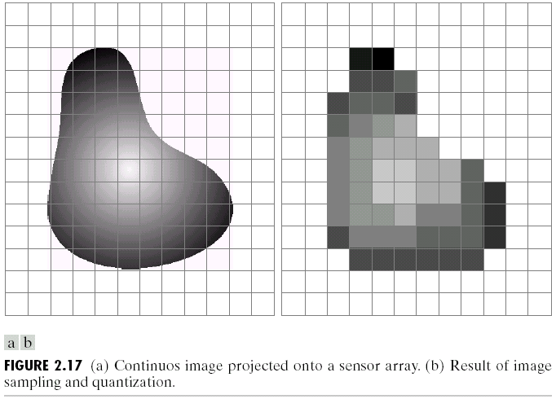

Slide 27
Conversion between real image (x,y) and pixel image (x_{im},y_{im}) coordinates
Assume
The image center (principal point) is located at pixel (c_{x},c_{y}) in the pixel image
The spacing of the pixels is (s_{x},s_{y}) in millimeters
Then
x = (x_{im} – c_{x}) s_{x}
y = (y_{im} – c_{y}) s_{y}
x_{im}
y_{im}
(c_{x}, c_{y})
x
y
x_{im} = x/s_{x} + c_{x}
y_{im} = y/s_{y} + c_{y}

Slide 28
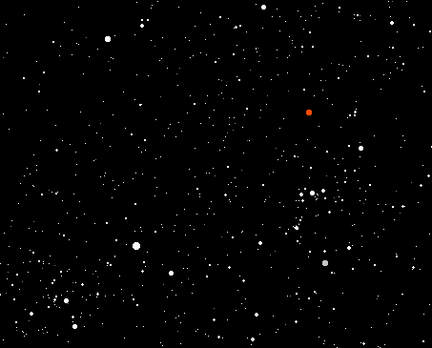
columns
Example
A star is located at pixel (r,c)=(100,200) in a telescope image
What is the 3D unit vector pointing at the star?
Assume:
Image is 1000x1000 pixels
Optical center is in the center of the pixel image
CCD plane is 10 mm x 10 mm
Focal length is 1 m
rows
Notes:
200 – 500 * (10mm/1000 = .01) 100 – 500 * .01
1000
V/|sqrt(vx^2 + vy^2 + vz^2)

Slide 29
columns
Example
A star is located at pixel (r,c)=(100,200) in a telescope image
What is the 3D unit vector pointing at the star?
Assume:
Image is 1000x1000 pixels
Optical center is in the center of the pixel image
CCD plane is 10 mm x 10 mm
Focal length is 1 m
rows
Pixel spacing s_{x} = 10mm/1000 px = .01mm v = x y f = (200-500)(.01) (100-500)(.01) 1000
(
)
(
)
Notes:
200 – 500 * (10mm/1000 = .01) 100 – 500 * .01
1000
V/|sqrt(vx^2 + vy^2 + vz^2)

Slide 30

Note on focal length
Recall
x = (x_{im} – c_{x}) s_{x}
y = (y_{im} – c_{y}) s_{y}
or
x_{im} = x/s_{x} + c_{x}
y_{im} = y/s_{y} + c_{y}
and
x = f X/Z
y = f Y/Z

Slide 31
Note on focal length
Recall
x = (x_{im} – c_{x}) s_{x}
y = (y_{im} – c_{y}) s_{y}
or
x_{im} = x/s_{x} + c_{x}
y_{im} = y/s_{y} + c_{y}
and
x = f X/Z
y = f Y/Z
So
x_{im} = (f / s_{x}) X/Z + c_{x}
y_{im} = (f / s_{y}) Y/Z + c_{y}

Slide 32
Note on focal length
Recall
x = (x_{im} – c_{x}) s_{x}
y = (y_{im} – c_{y}) s_{y}
or
x_{im} = x/s_{x} + c_{x}
y_{im} = y/s_{y} + c_{y}
and
x = f X/Z
y = f Y/Z
So
x_{im} = (f / s_{x}) X/Z + c_{x}
y_{im} = (f / s_{y}) Y/Z + c_{y}
All we really need is
f_{x} = (f / s_{x})
f_{y} = (f / s_{y})
We don’t need to know the actual values of f and s_{x},s_{y}; just their ratios
We can alternatively express focal length in units of pixels

Slide 33
Example
A camera observes a rectangle 1m away
The rectangle is known to be 20cm x 10cm
In the image, the rectangle measures 200 x 90 pixels
Focal length in x, focal length in y (pixels)?
If image size is 640x480 pixels, what is field of view (horiz, vert)?
Notes:
Similar triangles.
200/20 = x/100 : fx = 1000
90/10 = x/100 : fy = 900
2tan^{-1}(x/2)/fx = 2*tan^{-1}(640/2)/1000 : ~35*
2tan^{-1}(y/2)/fy = 2*tan^{-1}(480/2)/900 : ~30*

Slide 34
SUMMARY: CAMERA PARAMETERS AND COORDINATE FRAMES

Slide 35
Camera Parameters
Intrinsic parameters
Those parameters needed to relate an image point (in pixels) to a direction in the camera frame
f_{x}, f_{y}, c_{x}, c_{y}
Also lens distortion parameters (will discuss later)
Extrinsic parameters
Define the position and orientation (pose) of the camera in the world

Slide 36
Frames of Reference
Image frames are 2D; others are 3D
The “pose” (position and orientation) of a 3D rigid body has 6 degrees of freedom
{Camera}
Image plane or “real image”
{Model}
Frame buffer or “pixel image”
{World}

